Slide 2
What is Stemming
Stemming converts a word into its stem(root form).
Stemming is a rule based approach, it strips inflected words based on common prefixes and suffixes that can be found in an inflected word.
For example: Common suffix like: “es”, “ing”, “pre” etc.
Now if you want to apply stemming on a word “reading”, it will convert it to “read”. Just strip the suffix “ing” from the word which is available in stemming dictionary.
This is also applicable for prefix also. For Example: “pregame” to “game”
The root form generated by stemming is not necessarily a word by itself, but it can be used to generate words by concatenating the right suffix.
For example: The words study, studies and studying stems into studi, which is not an English word.
The most common algorithm for stemming is Porter’s Algorithm (Porter, 1980). It is only striping suffix of a word.

Slide 3
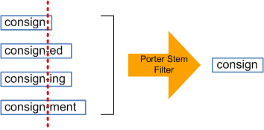

Slide 4
Stemming Algorithm Examples
Stemming Algorithm Examples
Porter stemmer:
Snowball stemmer:
Lancaster stemmer:

Slide 5
Stemming is a kind of normalization for words. Normalization is a technique where a set of words in a sentence are converted into a sequence to shorten its lookup. The words which have the same meaning but have some variation according to the context or sentence are normalized.
In another word, there is one root word, but there are many variations of the same words. For example, the root word is "eat" and it's variations are "eats, eating, eaten and like so". In the same way, with the help of Stemming, we can find the root word of any variations.

Slide 6
Porter stemmer: This stemming algorithm is an older one. It’s from the 1980s and its main concern is removing the common endings to words so that they can be resolved to a common form. It’s not too complex and development on it is frozen. Typically, it’s a nice starting basic stemmer, but it’s not really advised to use it for any production/complex application. Instead, it has its place in research as a nice, basic stemming algorithm that can guarantee reproducibility. It also is a very gentle stemming algorithm when compared to others.

Slide 7
Snowball stemmer: This algorithm is also known as the Porter2 stemming algorithm. It is almost universally accepted as better than the Porter stemmer, even being acknowledged as such by the individual who created the Porter stemmer. That being said, it is also more aggressive than the Porter stemmer. A lot of the things added to the Snowball stemmer were because of issues noticed with the Porter stemmer. There is about a 5% difference in the way that Snowball stems versus Porter.

Slide 8
Lancaster stemmer: Just for fun, the Lancaster stemming algorithm is another algorithm that you can use. This one is the most aggressive stemming algorithm of the bunch. However, if you use the stemmer in NLTK, you can add your own custom rules to this algorithm very easily. It’s a good choice for that. One complaint around this stemming algorithm though is that it sometimes is overly aggressive and can really transform words into strange stems. Just make sure it does what you want it to before you go with this option!

Slide 9
Stemming in Python NLTK
from nltk.stem.porter import * import nltk stemmer = PorterStemmer() # For single word print(stemmer.stem('builders')) print(stemmer.stem('good')) print(stemmer.stem('better')) print(stemmer.stem('run')) print(stemmer.stem('ran')) print(stemmer.stem('running'))
Output: builder good better run ran run

Slide 10
# For Sentence
sent = 'I have seen this yesterday'
tokens = nltk.word_tokenize(sent)
print('Word')
print(tokens)
stemd_word = [stemmer.stem(plural) for plural in tokens] print('Stemmed Form')
print(stemd_word)
Output: Word ['I', 'have', 'seen', 'this', 'yesterday'] Stemmed Form ['I', 'have', 'seen', u'thi', 'yesterday']

Slide 11
What is Lemmatization
Lemmatization converts a word into its lemma (root form).
Lemmatization usually refers to doing things properly with the use of a vocabulary and morphological analysis of words. It observes position and Parts of speech of a word before striping anything. For example consider two lemma's listed below:
1. saw [verb] - Past tense of see 2. saw [noun] - Cutting instrument
It normally aims to strip inflection from end of a word.
For word “saw”, stemming might return just “s”, whereas lemmatization would attempt to return either “see” or “saw” depending on whether the use of the token was as a verb or a noun.

Slide 12
Lemmatization is the algorithmic process of finding the lemma of a word depending on their meaning. Lemmatization usually refers to the morphological analysis of words, which aims to remove inflectional endings. It helps in returning the base or dictionary form of a word, which is known as the lemma. The NLTK Lemmatization method is based on WorldNet's built-in morph function. Text preprocessing includes both stemming as well as lemmatization. Many people find the two terms confusing. Some treat these as same, but there is a difference between these both. Lemmatization is preferred over the former because of the below reason.

Slide 13
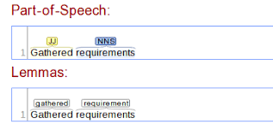

Slide 14
Lemmatization in Python NLTK
The NLTK Lemmatization method is based on WordNet’s built-in morphy function. This lemmatizer removes affixes only if the resulting word is found in lexical resource, wordnet.
from nltk.stem import WordNetLemmatizer
lemmatizer = WordNetLemmatizer()
# For single word
print(lemmatizer.lemmatize("good", pos='v')) print(lemmatizer.lemmatize("better", pos='a')) print(lemmatizer.lemmatize('run',pos='v')) print(lemmatizer.lemmatize('ran',pos='v')) print(lemmatizer.lemmatize('running',pos='v'))
Output:
good good run run run

Slide 15
# For sentence
sent = 'I have seen this yesterday'
tokens = nltk.word_tokenize(sent)
#Print each tokens
print(tokens)
lemma_word = [lemmatizer.lemmatize(plural) for plural in tokens]
lemma_word
# Print lemmatized sentence
print(' '.join(lemma_word))

Slide 16
Which one is best: lemmatization or stemming?
Stemming and Lemmatizing have their own flavour to normalize word.
The difference is that a stemmer operates on a single word without knowledge of the context, and therefore cannot discriminate between words which have different meanings depending on part of speech.
Stemming is much faster than Lemmatizing.
Accuracy of Stemming is much less than Lemmatization.

Slide 17
Why is Lemmatization better than Stemming?
Stemming algorithm works by cutting the suffix from the word. In a broader sense cuts either the beginning or end of the word.
On the contrary, Lemmatization is a more powerful operation, and it takes into consideration morphological analysis of the words. It returns the lemma which is the base form of all its inflectional forms. In-depth linguistic knowledge is required to create dictionaries and look for the proper form of the word. Stemming is a general operation while lemmatization is an intelligent operation where the proper form will be looked in the dictionary. Hence, lemmatization helps in forming better machine learning features.

Slide 18
Where to use stemming and where to use Lemmatization
It based on your requirement.
If you are handling huge amount of text and you only want to normalize and analyze text not to visualize, then you may go with stemming.
But if you want to visualize your normalized text then you should choose lemmatization as stem words may not necessarily the real world word.
Also you can anti stemming to your stemmed word to get real world word but as per my experience it will take huge amount of time to execute anti stemming task.

Slide 19
Conclusion:
In this topic I have tried to explain
What is stemming
What is Lemmatization
How to do Stemming in Python
How to do Lemmatization in Python
How Stemming and Lemmatization works
Which one could be your choice based on your requirement.

Slide 20
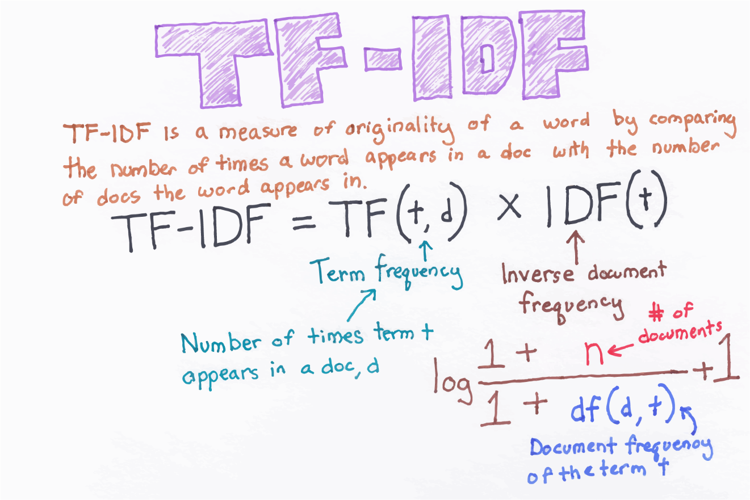

Slide 21
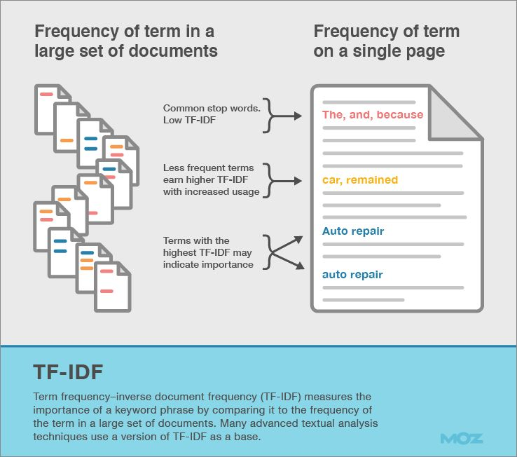

Slide 22
Term Frequency
Term frequency (TF) is how often a word appears in a document, divided by how many words there are.
TF(t) = (Number of times term t appears in a document) / (Total number of terms in the document)
Inverse document frequency
Term frequency is how common a word is, inverse document frequency (IDF) is how unique or rare a word is.
IDF(t) = log_e(Total number of documents / Number of documents with term t in it)

Slide 23
Example, Consider a document containing 100 words wherein the word appleappears 5times. The term frequency (i.e., TF) for apple is then (5 / 100) = 0.05.
Now, assume we have 10 million documents and the word apple appears in one thousand of these. Then, the inverse document frequency (i.e., IDF) is calculated as log(10,000,000 / 1,000) = 4.
Thus, the TF-IDF weight is the product of these quantities: 0.05 * 4 = 0.20.

Slide 24
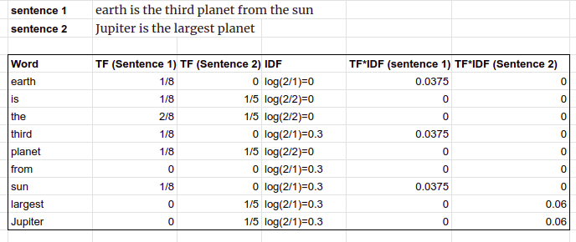

Slide 25
Why is TF-IDF used in Machine Learning?
Machine learning with natural language is faced with one major hurdle – its algorithms usually deal with numbers, and natural language is, well, text. So we need to transform that text into numbers, otherwise known as text vectorization. It’s a fundamental step in the process of machine learning for analyzing text, and different vectorization algorithms will drastically affect end results, so you need to choose one that will deliver the results you’re hoping for.
Once you’ve transformed words into numbers, in a way that’s machine learning algorithms can understand, the TF-IDF score can be fed to algorithms such as Naive Bayes and Support Vector Machines, greatly improving the results of more basic methods like word counts.
Why does this work? Simply put, a word vector represents a document as a list of numbers, with one for each possible word of the corpus. Vectorizing a document is taking the text and creating one of these vectors, and the numbers of the vectors somehow represent the content of the text. TF-IDF enables us to gives us a way to associate each word in a document with a number that represents how relevant each word is in that document. Then, documents with similar, relevant words will have similar vectors, which is what we are looking for in a machine learning algorithm.

Slide 26
Applications of TF-IDF
Information retrieval
TF-IDF was invented for document search and can be used to deliver results that are most relevant to what you’re searching for. Imagine you have a search engine and somebody looks for LeBron. The results will be displayed in order of relevance. That’s to say the most relevant sports articles will be ranked higher because TF-IDF gives the word LeBron a higher score.
It’s likely that every search engine you have ever encountered uses TF-IDF scores in its algorithm.
Keyword Extraction
TF-IDF is also useful for extracting keywords from text. How? The highest scoring words of a document are the most relevant to that document, and therefore they can be considered keywords for that document. Pretty straightforward.

Slide 27
Word Frequency
Counting Words
Word frequency is word counting technique in which a sorted list of words and their frequency is generated, where the frequency is the occurrences in a given composition. It is used commonly in computational linguistics.

Slide 28
Why Should I Care?
Word frequency has many applications in diverse fields. Within pedagogy, it allows teaching to cover high-frequency vocabulary before the low-frequency ones, enabling the development of better class curriculum.
But let's talk about a field that any developer might find compelling, which are analytics. In my case, I worked for a publisher that required analytics to suggest vocabulary improvements, detect trends in word usage, and determine payment for their writers.
Yes, you read that last part correctly — payment is determined by many publishers based on the number and complexity of the wording.

Slide 29
The first thing we need is a document to perform the word frequency on, for this example I will use The Beast in the Cave, a short story by American horror fiction writer H.P. Lovecraft — more about the plot here. We will save the story (below) as a text file named The Beast.txt.

Slide 30
Find frequency of each word in a string in Python
Write a python code to find the frequency of each word in a given string.
Input : str[] = "Apple Mango Orange Mango Guava Guava Mango" Output : frequency of Apple is : 1 frequency of Mango is : 3 frequency of Orange is : 1 frequency of Guava is : 2 Input : str = "Train Bus Bus Train Taxi Aeroplane Taxi Bus" Output : frequency of Train is : 2 frequency of Bus is : 3 frequency of Taxi is : 2 frequency of Aeroplane is : 1

Slide 31
Approach 1 using list():
1. Split the string into a list containing the words by using split function (i.e. string.split()) in python with delimiter space.
Note: string_name.split(separator) method is used to split the string by specified separator(delimiter) into the list. If delimiter is not provided then white space is a separator.
For example: CODE : str='This is my book' str.split() OUTPUT : ['This', 'is', 'my', 'book']

Slide 32
2. Initialize a new empty list. 3. Now append the word to the new list from previous string if that word is not present in the new list. 4. Iterate over the new list and use count function (i.e. string.count(newstring[iteration])) to find the frequency of word at each iteration.
Note: string_name.count(substring) is used to find no. of occurrence of substring in a given string. For example: CODE : str='Apple Mango Apple' str.count('Apple') str2='Apple' str.count(str2) OUTPUT : 2 2

Slide 33
# Python code to find frequency of each word
def freq(str):
# break the string into list of words
str = str.split()
str2 = []
# loop till string values present in list str
for i in str:
# checking for the duplicacy
if i not in str2:
# insert value in str2
str2.append(i)
for i in range(0, len(str2)):
# count the frequency of each word(present
# in str2) in str and print
print('Frequency of', str2[i], 'is :', str.count(str2[i]))
def main():
str ='apple mango apple orange orange apple guava mango mango'
freq(str)
if __name__=="__main__":
main() # call main function

Slide 34
Approach 2 using set(): 1. Split the string into a list containing the words by using split function (i.e. string.split()) in python with delimiter space. 2. Use set() method to remove a duplicate and to give a set of unique words 3. Iterate over the set and use count function (i.e. string.count(newstring[iteration])) to find the frequency of word at each iteration.

Slide 35
# Python3 code to find frequency of each word
# function for calculating the frequency
def freq(str):
# break the string into list of words
str_list = str.split()
# gives set of unique words
unique_words = set(str_list)
for words in unique_words :
print('Frequency of ', words , 'is :', str_list.count(words))
# driver code
if __name__ == "__main__":
str ='apple mango apple orange orange apple guava mango mango'
# calling the freq function
freq(str)

Slide 36
https://www.geeksforgeeks.org/find-frequency-of-each-word-in-a-string-in-python/

